Slide 1
INTRODUCTION
NAME:R.SAICHANDRA
ROLL:24R01A66H7
CLASS:CSM-C

Slide 2
TYPES OF BINARY TREE
FULL BINARY TREE
PERFECT BINARY TREE
COMPLETE BINARY TREE
PATHALOGICAL BINARY TREE

Slide 3
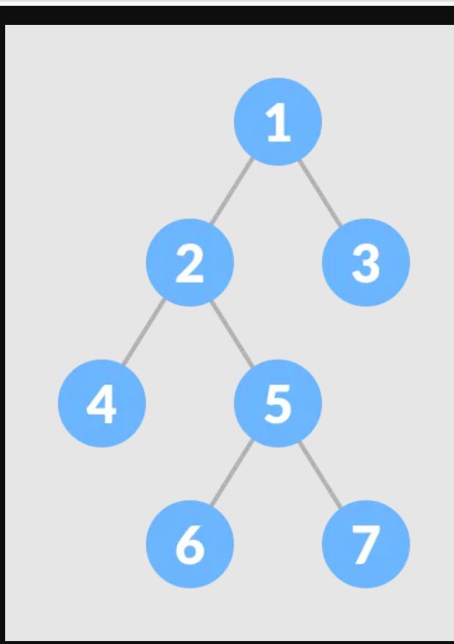
FULL BINARY TREE
It contain either one or
Two child is called full
binary tree.

Slide 4
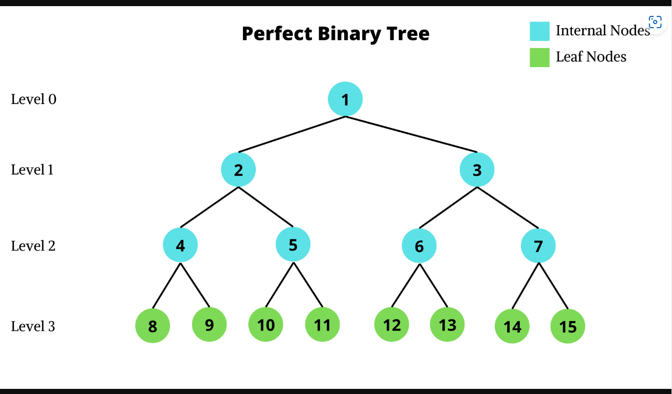
2.PERFECT BINARY TREE
All internal nodes have exactly two children.
All leaf nodes are at same
Level.

Slide 5
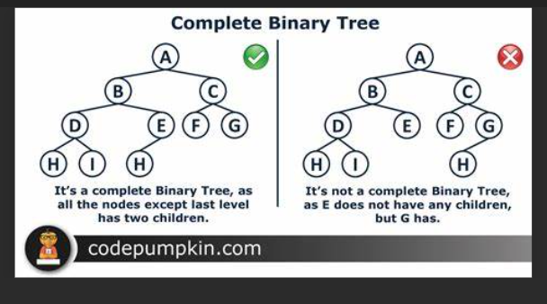
3.COMPLETE BINARY TREE
A complete binary tree is a type of binary tree where every level, except possibly the last one, is fully filled with nodes. In a complete binary tree:
The number of nodes at depth dd is \(2\^d\)

Slide 6
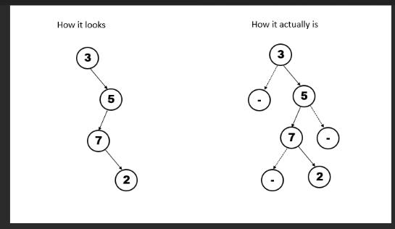
4.PATHALOGICAL BINARY TREE
A Tree where every internal node has one child. Such trees are performance-wise same as linked list. A degenerate or pathological tree is a tree having a single child either left or right.

Slide 7


